Slide 1
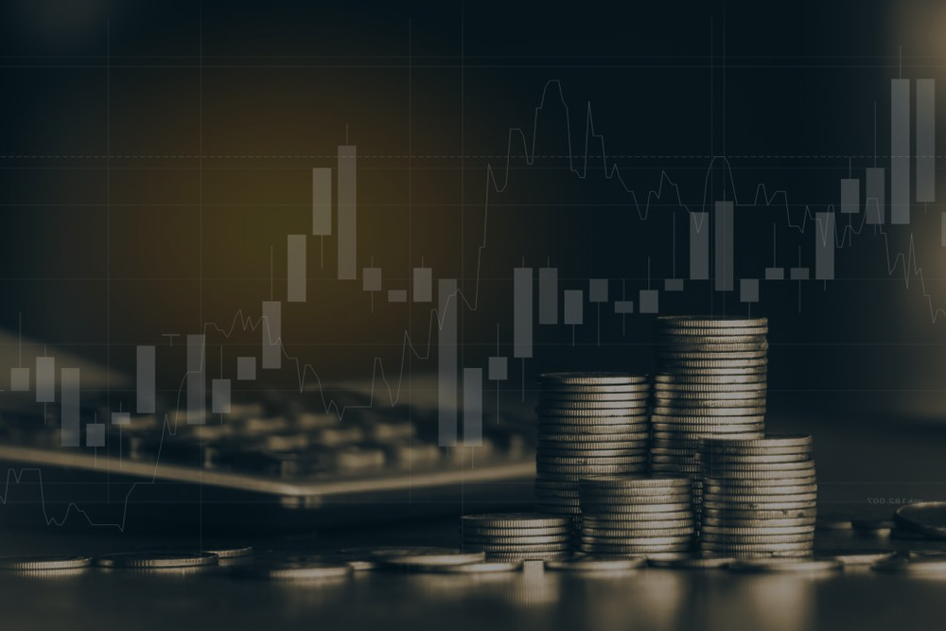
Analyzing investment strategies
Group Members:
H van Dijk (223227354)
MC Lebese (219042116)
B Nqwaba (219115748)

Slide 2
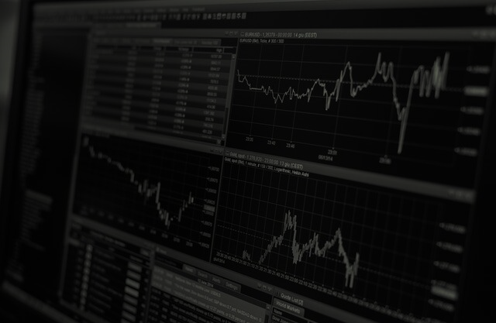

Meet Yvette
Yvette is a twenty-five year old woman who has inherited R100,000. As HBM Finances Inc. she has approached us to advise her in the best investment strategy. We have created a presentation to explain to her the importance of choosing the right investment fund and to show her what her options are in the current market.

Slide 3
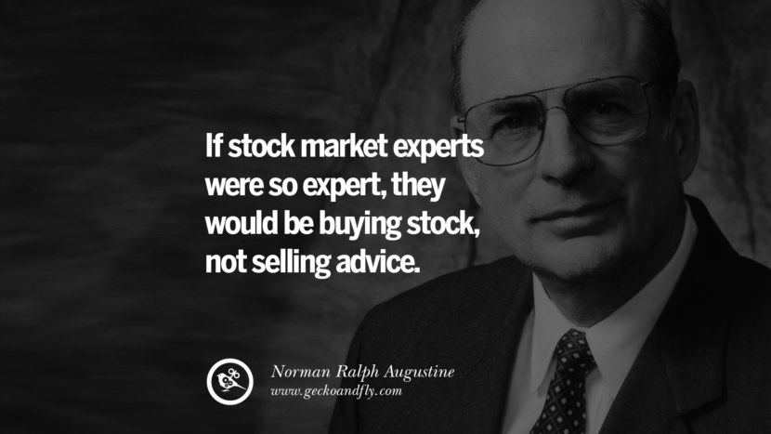
Importance of doing research…!!!

Slide 4
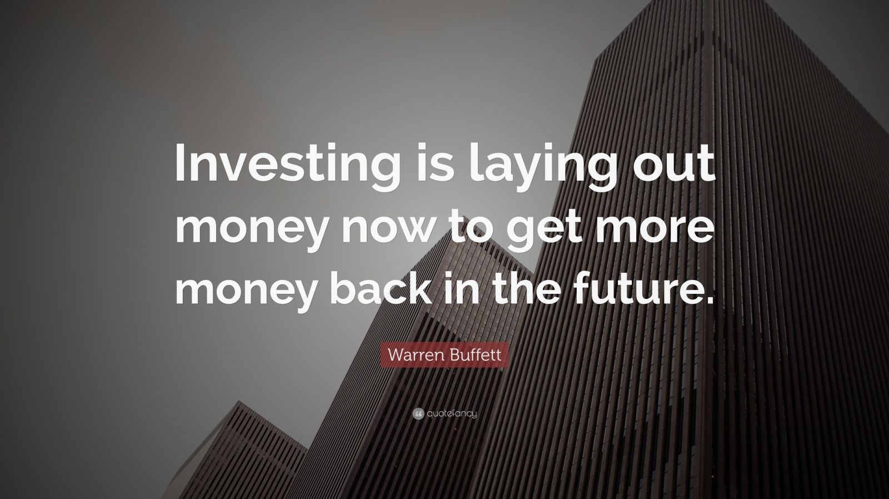
Why Yvette needs to invest?

Slide 5
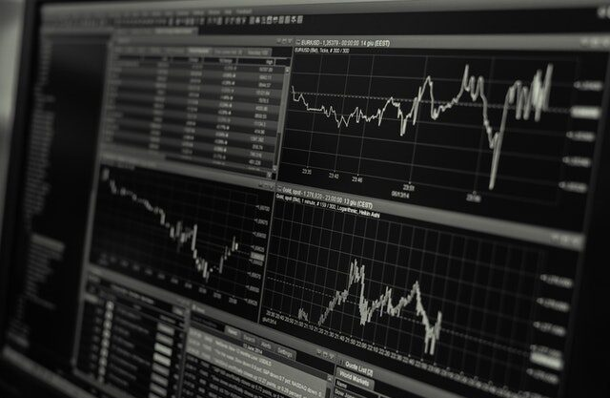

Our Objectives of this analysis for Yvette:
Identify 4 exchange traded funds best suited for future investment.
Analyze historical data of the selected exchange traded funds.
Use regression techniques to establish future growth potential.
Select fund to invest R100k and motivate the selection taking other economic factors into account.

Slide 6
Exchange Traded Funds
What is an ETF ?
An Exchange Traded Fund (ETF) is a structured investment instrument specifically created to track the performance of an existing stock, a particular index, commodities, or any specific asset.
(What is an Exchange Traded Fund (ETF), 2023)
Why ETF?
Diversification, which helps mitigate and lower the risk of the investor’s portfolio, may be one of the essential strategies to endure the market’s volatility better. Rather than researching and identifying each stock and instrument to invest in to pursue optimal asset allocation, investors are afforded several methods they may utilize to diversify their portfolio. One security available at an investor’s disposal is an Exchange Traded Fund (ETF).
(What is an Exchange Traded Fund (ETF), 2023)

Slide 7
ETF’s that Yvette can select from:
Vanguard S&P 500:
The S&P 500 represents 500 of the largest U.S. companies. The goal of the Vanguard S&P 500 ETF is to track the returns of the S&P 500 index
Satrix 40:
This ETF tracks the FTSE/JSE Top 40 Index, which is a market capitalization-weighted index that comprises the 40 largest companies listed on the Johannesburg Stock Exchange (JSE).
Satrix Indi:
This ETF tracks the FTSE/JSE Africa Index Series, which is a market capitalization-weighted index that comprises the 25 largest companies listed on the JSE that are not included in the FTSE/JSE Top 40 Index.
Sygnia Itrix MSCI World ETF:
This ETF tracks the performance of the MSCI World Index, which is a market capitalization-weighted index that comprises companies from 23 developed countries around the world.

Slide 8
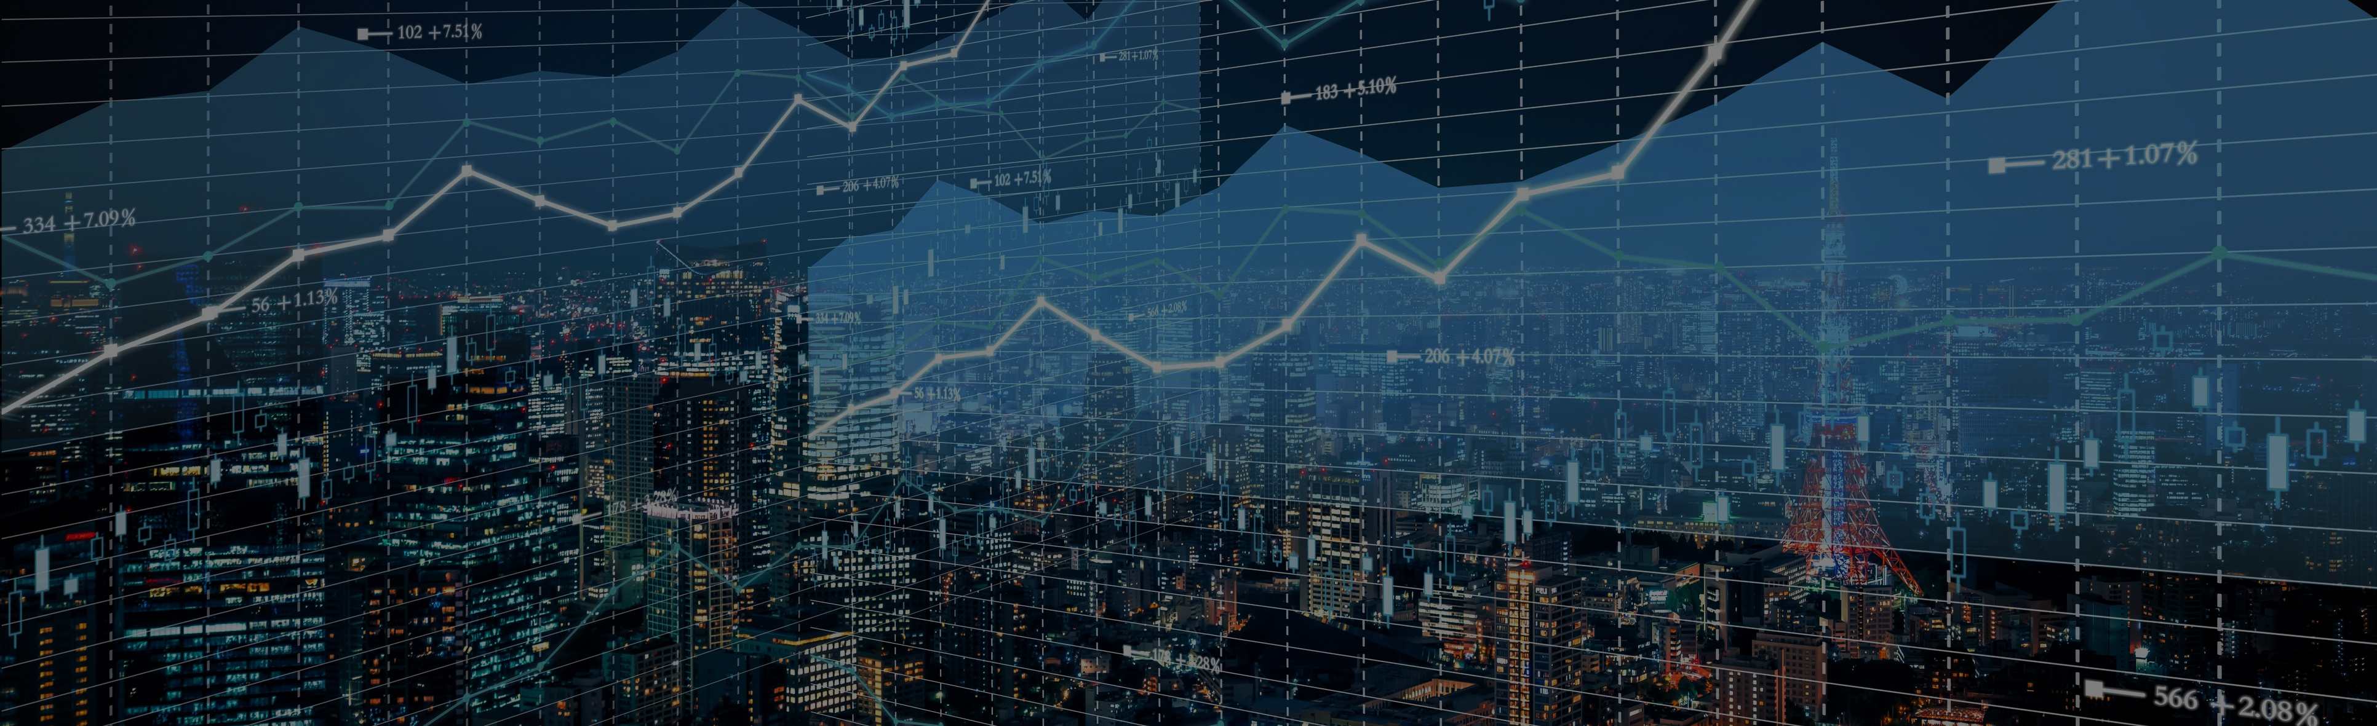
Investment Analysis

Slide 9
Descriptive analysis
S&P 500 and Sygnia Itrix MSCI reflecting higher growth.
Impact of USD/ZAR Exchange Rate:
Share price remained flat in terms of USD but reflected growth in Rands because of declining ZAR exchange rate.

Slide 10
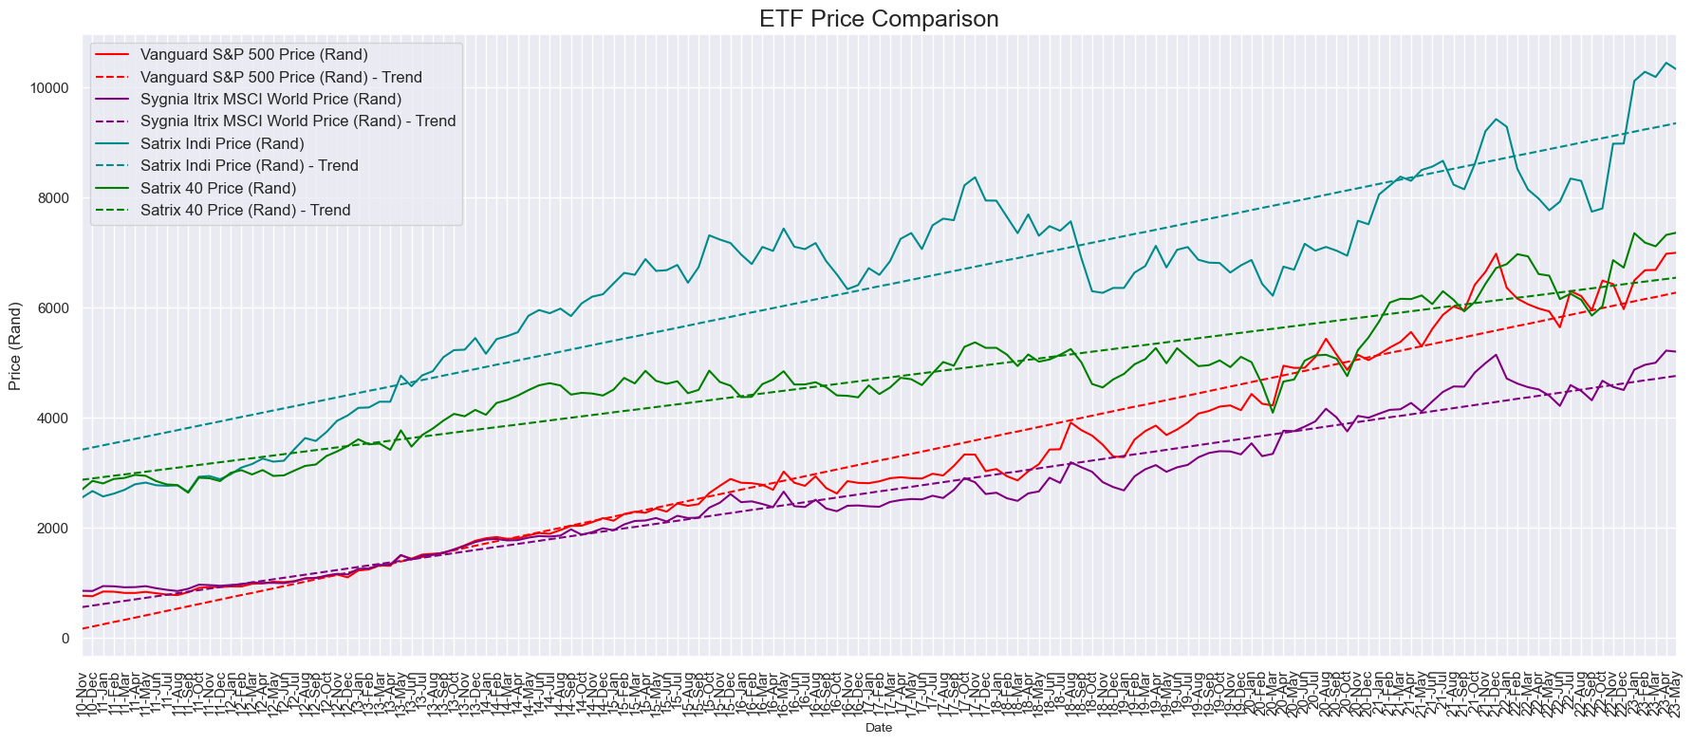
All ETF’s reflected long term growth in ZAR:
Trend lines uses the least squares regression analysis methodology
All the funds reflected growth over the period under review although some funds performed better than others.

Slide 11
Regression analysis (Formula Example)
The least squared regression method was used to plot the growth trends reflected in the previous slide.
This example on the left includes the calculation for the Vanguard S&P 500 ETF although the same calculation was applied to all four funds.
The “TREND” function in excel can be used to do the same analysis (Refer to Excel workings on GitHub)
This regression formula was used to forecast future growth.

Slide 12
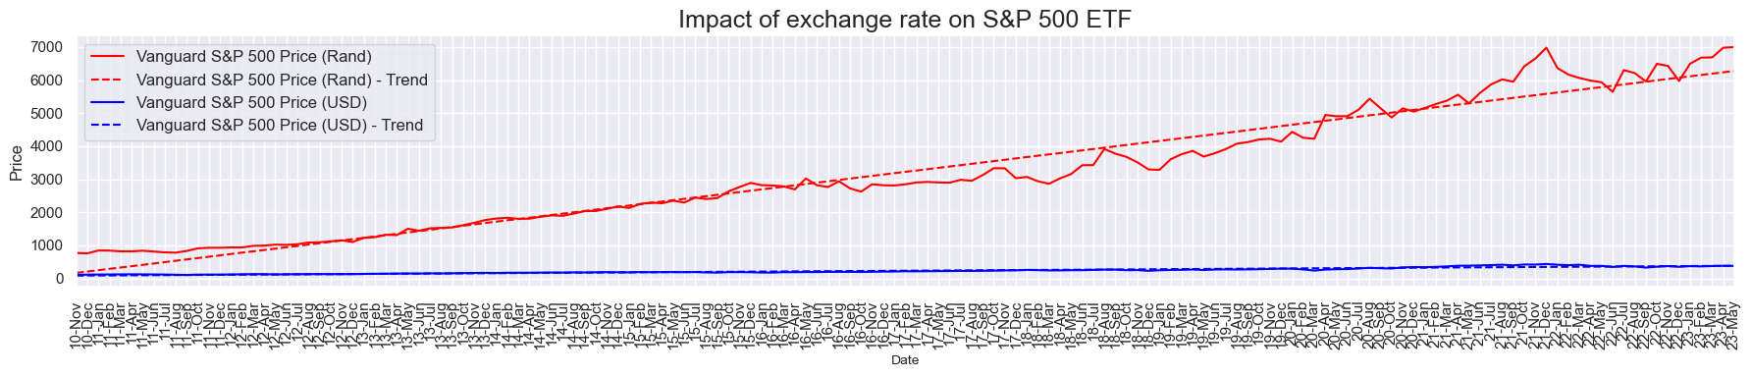
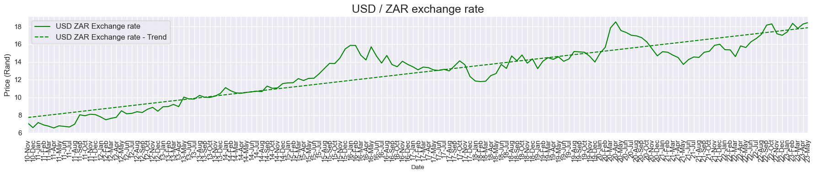
Exchange rate impact on investments:
Although the S&P 500 Price reflected extremely low growth in terms of USD, the fund showed significant growth in SA rands due to the increase in exchange rate, highlighting the importance of considering exchange rates when analysing ETF performance.

Slide 13
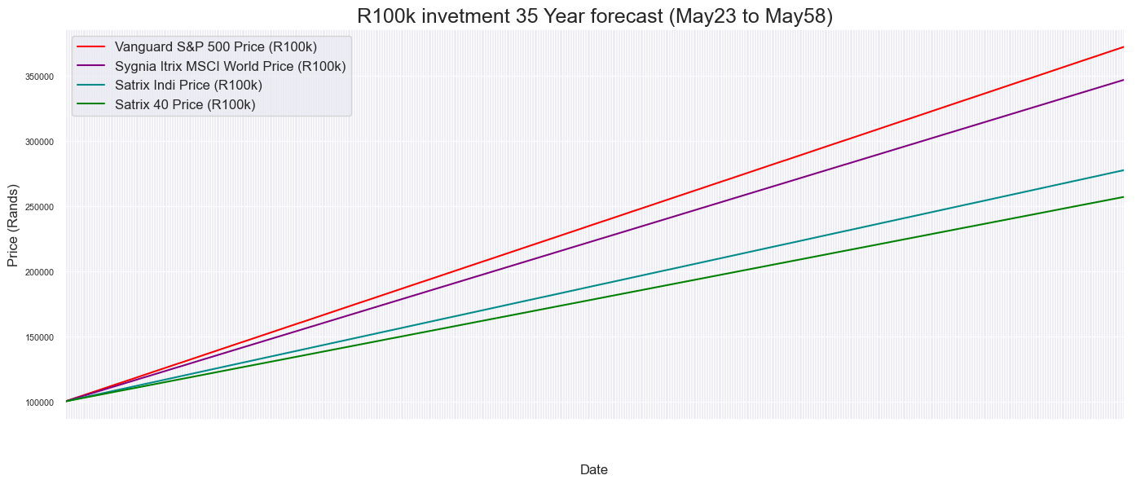
R100k investment forecasted growth
R372 468
R347 128
R277 726
R257 183
Forecast uses the least squares regression analysis methodology
May 2023
May 2058
The S&P 500 Index outperformed the other funds growing the R100k investment to R 372 468 over the next 35 years.
The Sygnia Itrix MSCI fund shows more moderate growth of growing the R100k investment to R 347 128.

Slide 14

Environmental Factors

Slide 15
Other environmental factors that Yvette should take into account before making a decision:
Vanguard S&P 500:
This fund is highly susceptible to changes in exchange rate as reflected in the previous slides.
Growth in this fund could mainly be attributed to the exchange rate.
Satrix 40 / Satrix Indi :
These fund tracks performance of SA companies.
SA Economic growth forecast remain low. National Treasury’s baseline forecast for GDP growth remain low at 0.9% for 2023.
Increased energy concerns put additional pressure on SA companies.
Sygnia Itrix MSCI World ETF:
This fund is slightly more diversified tracking the performance of the MSCI World Index comprising of companies from 23 developed countries around the world.

Slide 16
Other environmental factors that Yvette should take into account before making a decision…. Continued:
Climate Change: The physical and financial effects of climate change are anticipated to worsen over the next two decades, which could result in more regulation and cost increases for businesses in carbon-intensive industries.
Demographics: Aging populations in the US and other industrialized nations may influence consumer purchasing habits and the performance of specific industries, such healthcare and retirement services.
Technology innovation: The rate of technological development is projected to keep accelerating, opening the door for the emergence of new markets and business models as well as industries.

Slide 17
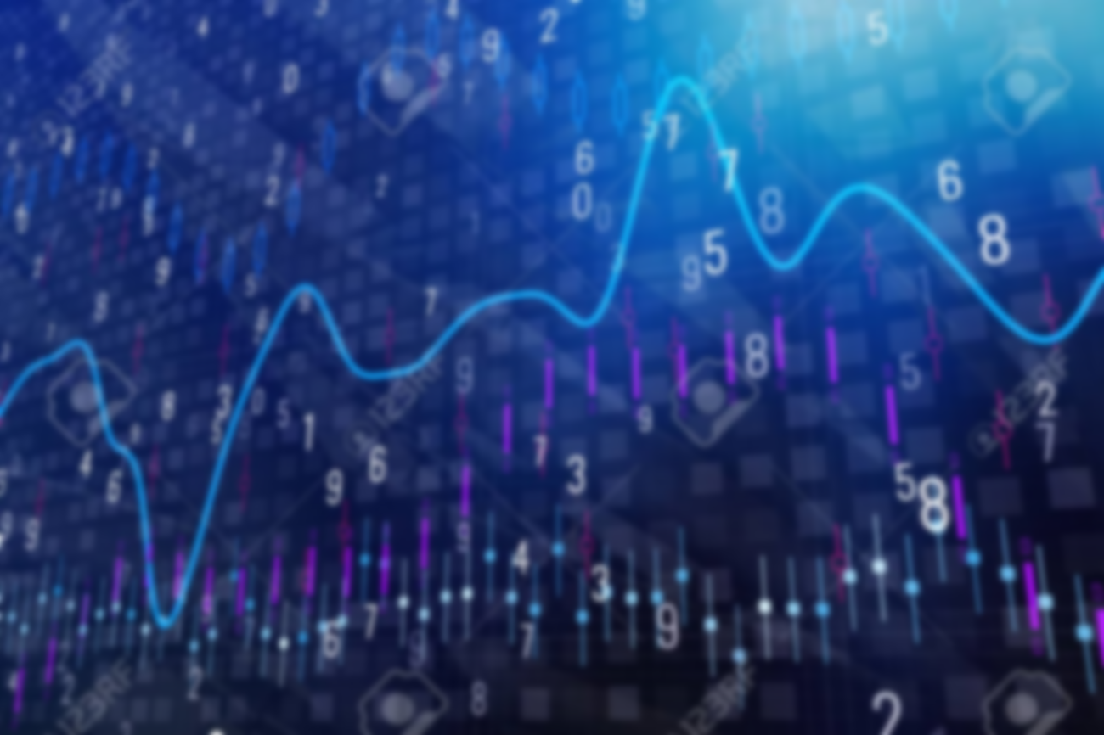
Synthesis and Recommendation:

Slide 18
Synthesis and Recommendations:
We have proposed the Sygnia Itrix MSCI World ETF to Yvette for her to invest her R100k because of the following:
The fund is more diversified tracking 25 developed countries world wide.
It had the second highest return of the funds but is less reliant on the USD/ZAR exchange rate.
It does not predominantly include SA markets where future economic growth is uncertain.
The fund reflected continues stable growth over the past 12 years.

Slide 19
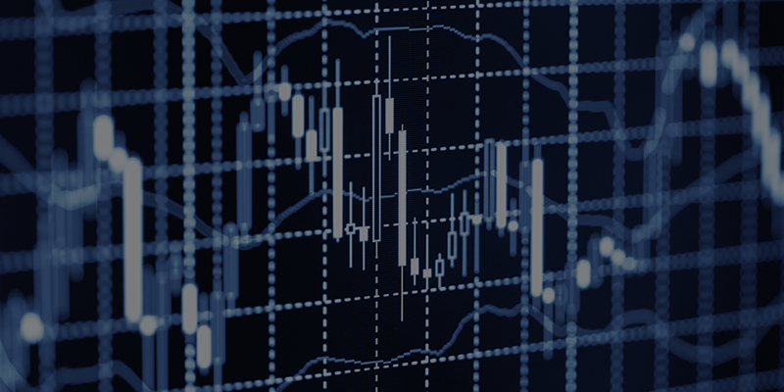
Reflections:

Slide 20
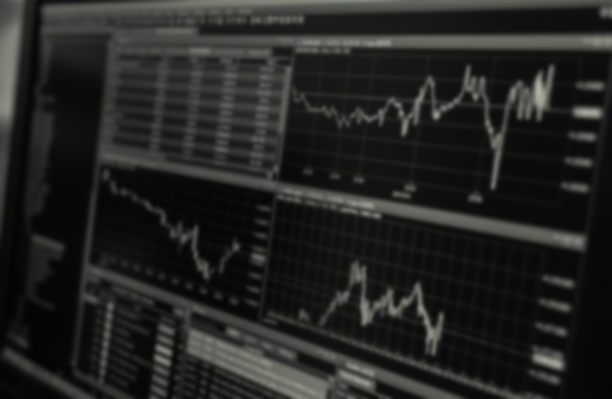
Markets are complex and unpredictable, and data analysis is essential for understanding them. Visualizations can help make sense of data, and risk management is key to successful trading. Risk management includes diversifying portfolios and setting stop-loss orders, and continuous learning is important to stay up to date on developments. As a group our data analyzing skills have improved a lot. We can now analyze, clean, and manipulate data through different kinds of statistics. We got to learn about statistics, since we were not exposed to most of it during our undergraduate studies. And we got to learn about one of the most important statistics, which is regression. Regression can be used to solve most problems and we are glad we got exposed to it and how to go about using it in different scenarios. In terms of Python, it is a wide programming language that can be used for various things and during this semester we discovered how easier Python can make data analysis. We improved and expanded our prior knowledge on how to code and work with python and learned how to use a new IDE. Overall, for all three of us, the course has been eye-opening, and we have enjoyed using Python in different ways. We will use our knowledge on python, statistics, and EFTs to make better choices financially and for the future.

Slide 21
Data Gathered
Source: https://za.investing.com
Monthly Share Price Data collected across all 4 ETF’s
USD/ZAR exchange rate Data
https://github.com/HenkVanDijk-hub/GroupAssignment4InvAnalysis.git
Analytics was done using both Python and Excel.
All graph presentations were done using Python.

